Slide 1

Team Double Ones
Will a Customer Subscribe to a Term Deposit?

Slide 2
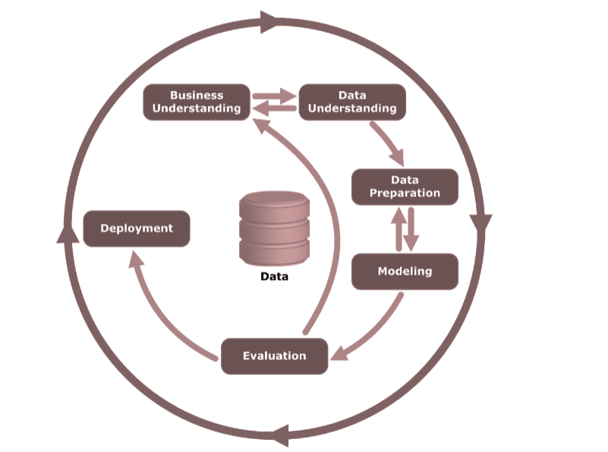
Agenda
Data
Based on the dataset about records of telemarketing calls for a Portuguese Bank
Key Task: Predict whether the customer will subscribe to a term deposit following the call
4 major aspects of information for predictive analysis and decision making
client characteristics
current campaign data
historical campaign data
socio-economic factors
https://archive.ics.uci.edu/ml/datasets/Bank+Marketing, bank-additional-full.csv

Slide 3
Business Understanding
What is a Term Deposit?
A fixed-term investment that includes the deposit of money into an account for an agreed rate of interest
Investors can only withdraw the money once the term ends
What type of problem is this?
Binary classification problem of the target variable
Will the customer subscribe or not? --”Yes”(encoded “1”) or “No”(encoded “0”)
Why is this prediction problem important?
Source of Profit
Key Performance Goals for direct marketing campaigns in banks
Predictive Analytics - Optimize the marketing strategies and improve success rates
Business Understanding
Data Understanding
Data Preparation
Model
Evaluation
Deployment
Notes:
Source : https://www.investopedia.com/terms/t/termdeposit.asp
Banks make money by lending account holders’ funds to others; Term deposits ensure bank a certain amount of money in a term available to be lent out in case of uncertainty of account holders’ drawbacks
Effective outreach to potential customers and actual conversion for the product are
Predictive analytics help managers optimize the marketing strategies (e.g.: customers to target; timing, frequency and channels of outreach) and improve success rates

Slide 4
Data Understanding: Overview
Original Dataset:
20 Features & 1 Target Variable (“y”: whether the customer has deposited or not)
Features including - ‘age’, ‘job’, ‘marital’, ‘education’, ‘default’, ‘housing’, ‘loan’, ‘contact’, ‘month’, ‘day_of_week’, ‘duration’, ‘campaign’, ‘pdays’*, ‘previous’, ‘poutcome’, ‘emp.var.rate’, ‘cons.price.idx’, ‘cons.conf.idx’, ‘euribor3m’ & ‘nr.employed'
41,188 observations
Problems detected:
Data Imbalance: 4640 ‘yes’ (11.3%) vs. 36548 ‘no’ (88.7%)
Data Leakage: “Duration” feature
Extremely correlated with target variable (y=No’ if duration=0)
Information not available at the time of decision making (call duration not known when making the call)
Business Understanding
Data Understanding
Data Preparation
Model
Evaluation
Deployment
Notes:
The Euro Interbank Offered Rate (Euribor) is a daily reference rate, based on the averaged interest rates at which Eurozone banks offer to lend unsecured funds to other banks in the euro wholesale money market (or interbank market).
duration: duration of last contact, in seconds (numeric).
campaign: number of contacts performed during this campaign and for this client (numeric, includes last contact)
pdays: number of days that passed by after the client was last contacted from a previous campaign (numeric; 999 means client was not contacted in the previous campaign)
previous: number of contacts performed before this campaign and for this client (numeric)
poutcome: outcome of the previous marketing campaign (categorical: "failure","nonexistent","success")
emp.var.rate: employment variation rate - quarterly (numeric)
cons.price.idx: (CPI)consumer price index - monthly (numeric)
cons.conf.idx: consumer confidence index - monthly (numeric)
euribor3m: euribor 3 month rate - daily (numeric)
nr.employed: number of employees - quarterly (numeric)

Slide 5
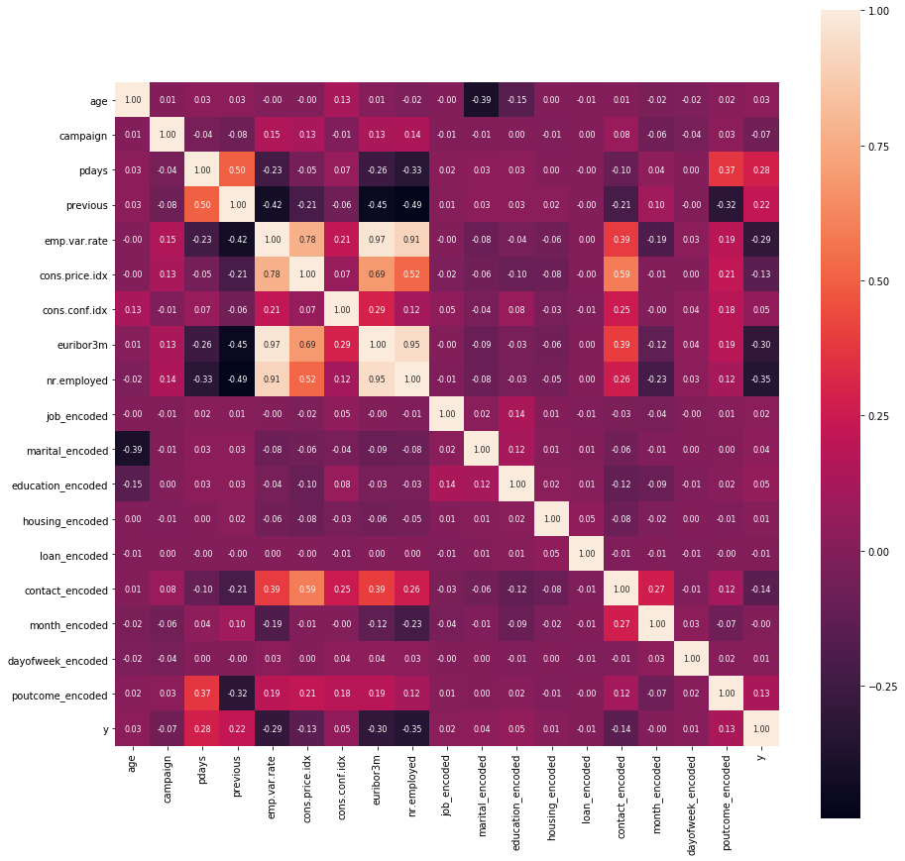
Data Understanding: Variable Correlation
Top features correlated with the target variable (indicating more possible importance):
“nr.employed”
“euribor3m”
“emp.var.rate”
“pdays”
“previous”
A little possible multicollinearity among some socio-economic factors
yet broader economic context matters
different aspects of macroeconomic conditions are reflected
Business Understanding
Data Understanding
Data Preparation
Model
Evaluation
Deployment
Notes:
“nr.employed”: number of employees indicator
“euribor3m”: euribor 3 month rate indicator
“emp.var.rate”: employment variation rate indicator
“pdays”: number of days passed by after the client was last contacted from a previous campaign (999 means client was not previously contacted)
“previous”: number of contacts performed before this campaign and for this client
Possible Multi-collinearity
euribo3m & emp.var.rate
euribo3m & nr.employed
emp.var.rate & nremployed
However, we chose to leave in these variables because they measure different aspects of the macroeconomic health

Slide 6
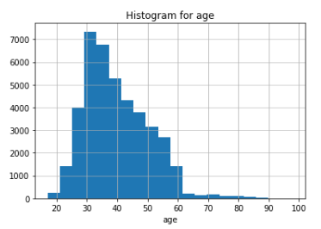
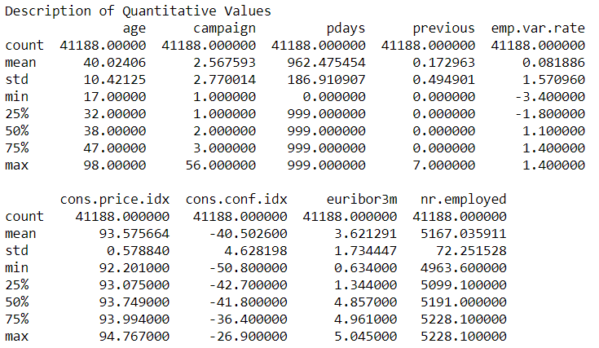
Data Understanding: Numeric Features
‘age’, ‘campaign’, ‘previous’, ‘pdays’, ‘emp.var.rate’, ‘cons.price.idx’, ‘cons.conf.idx’, ‘euribor3m’, ‘nr.employed’
Right-Skewness
e.g.: ‘age’, ‘campaign’, ‘previous’
Left-Skewness
e.g.: ‘euribor3m’, ‘nr.employed’, ‘emp.var.rate’
Special notation:
“‘pdays”: the value of “999” actually represents ‘customer not contacted in last campaign’ -> turned to be encoded as “-1” later
Business Understanding
Data Understanding
Data Preparation
Model
Evaluation
Deployment

Slide 7
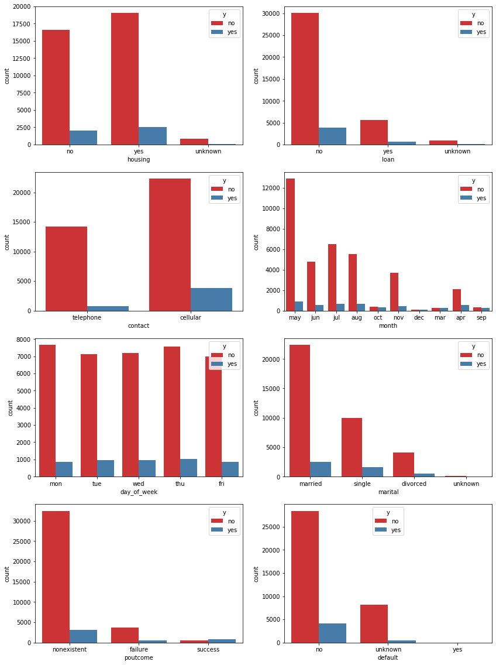
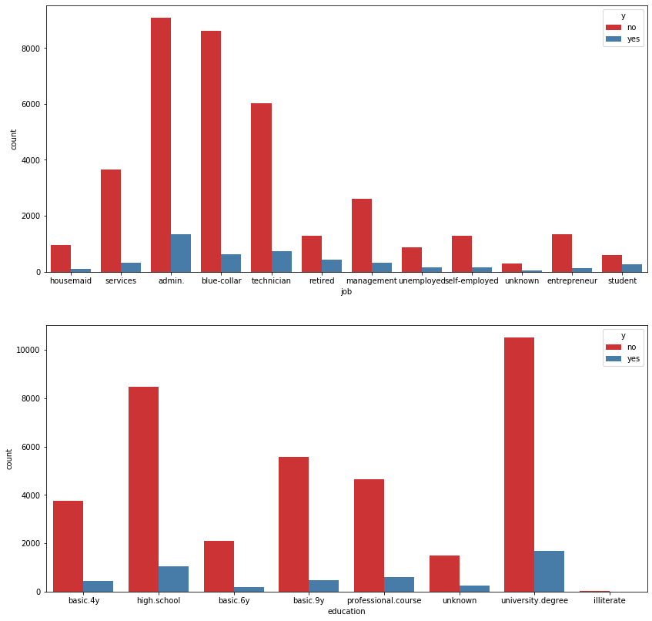
Data Understanding: Categorical Features
Categorical variable in text format
e.g.: “contact”: {“cellular, “telephone”}
“Unknown’s” in categorical features: “Job”(0.8%), ‘marital’(0.2%), ‘education’(4.2%), ‘default’(20.9%), ‘housing’(2.4%), ‘loan’(2.4%)
“month”
The month with the highest level of marketing activities is May.
“contact”
Customers reached out via 'telephone' type of contact seem less likely to subscribe.
“poutcome”
Customers who subscribed in previous marketing campaign more likely do it again.
“job”
Students or retired people seem more likely to be customers for term deposit subscription.
Business Understanding
Data Understanding
Data Preparation
Model
Evaluation
Deployment

Slide 8
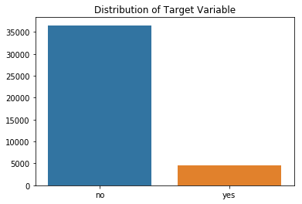
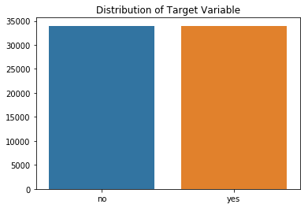
Data Preparation
3 types of models: Basic, Basic Optimized, Transformed Optimized
Remove Observations with ‘unknown’s
Data Rebalancing with Resampling Technique
Removed data points with any ‘unknown’ in feature vector’ (92.9% data points remaining)
Oversampling of Minority class. The two labeled classes achieve exactly 50/50 ratio; 67,974 observations after resampling
To Jupyter!
Remove Features
Categorical Data Encoder
Transformations
Removed:
‘duration’ - data leakage;
‘default’ - not informative
Transformed the data to make features approximate normal distribution as much as possible
Encoded the 9 categorical variables using LabelEncoder
Business Understanding
Data Understanding
Data Preparation
Model
Evaluation
Deployment
Notes:
***Transformations:
Log Transformations
age: log()
campaign: log()
Log Transformations for
Features with ‘0’
pdays: log(x+2)
previous: log(x+2)
job_encoded: log(x+2)
housing_encoded: log(x+2)
loan_encoded: sqrt(x+2)
contact_encoded: sqrt(x+2)
Sqrt Transformations for Features with Negative Values
cons.conf.idx: sqrt(x+1- min(X[]))

Slide 9
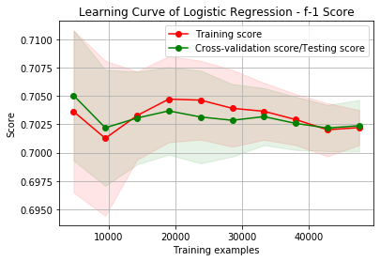
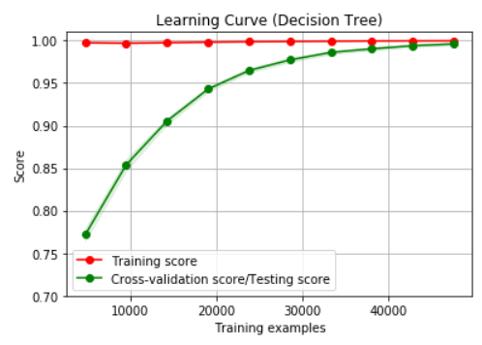
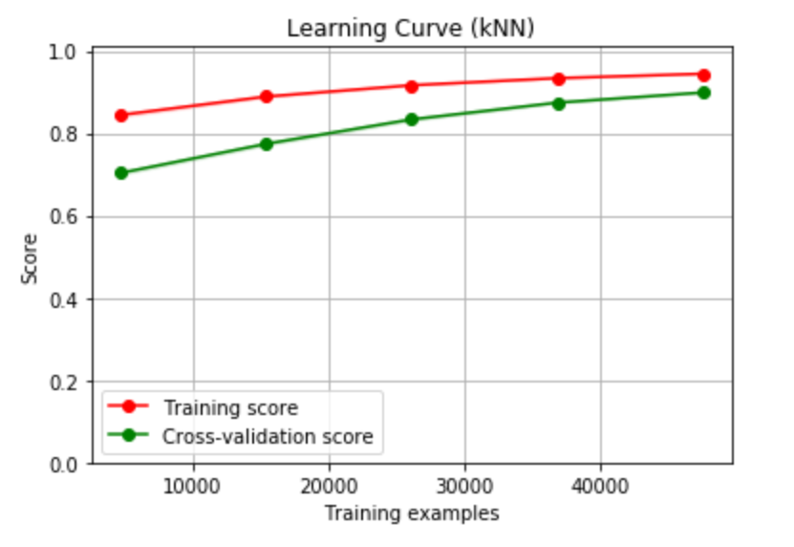
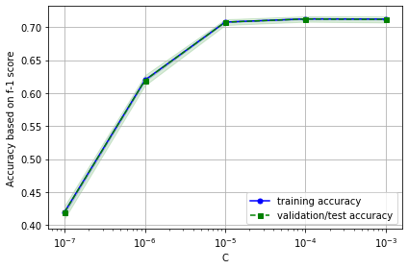
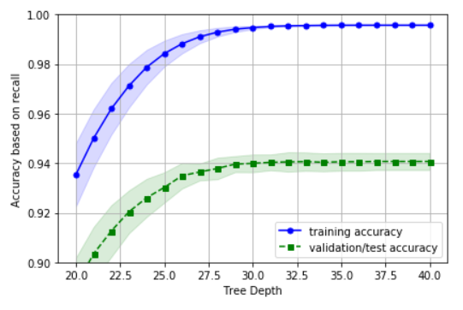
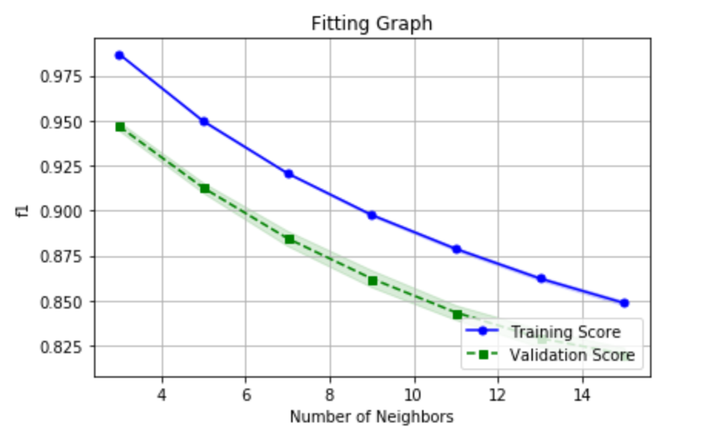
Model: Basic Default
Logistic Regression
Decision Tree
k-Nearest Neighbor
Default Parameters
C = 1.0
Penalty = ‘l2’
F1 = 0.7274
Default Parameters
Criterion = ‘gini’
Min_Samples_Split =2
F1 = 0.9407
Default Parameters 3-NN
Euclidean Distance
Minkowski
F1 = 0.8935
Business Understanding
Data Understanding
Data Preparation
Model
Evaluation
Deployment
Notes:
IMPORTANT:
our main evaluation metric for this project is “F1 score”!!
“Why F1”: want to both balance between ‘targeting customers who would actually convert’ and ‘not waste resource targeting those who would not actually convert’ in practice

Slide 10
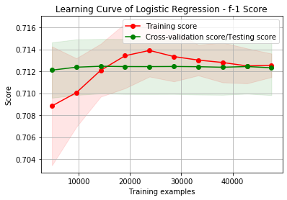
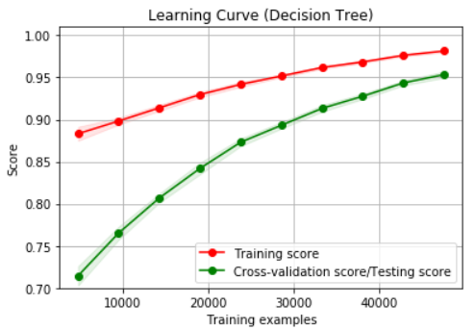
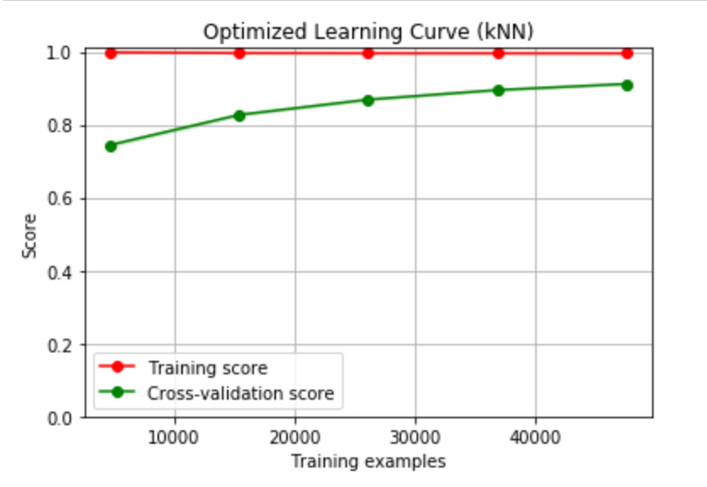
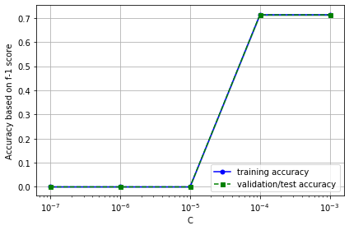
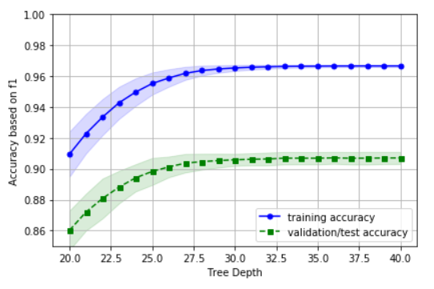
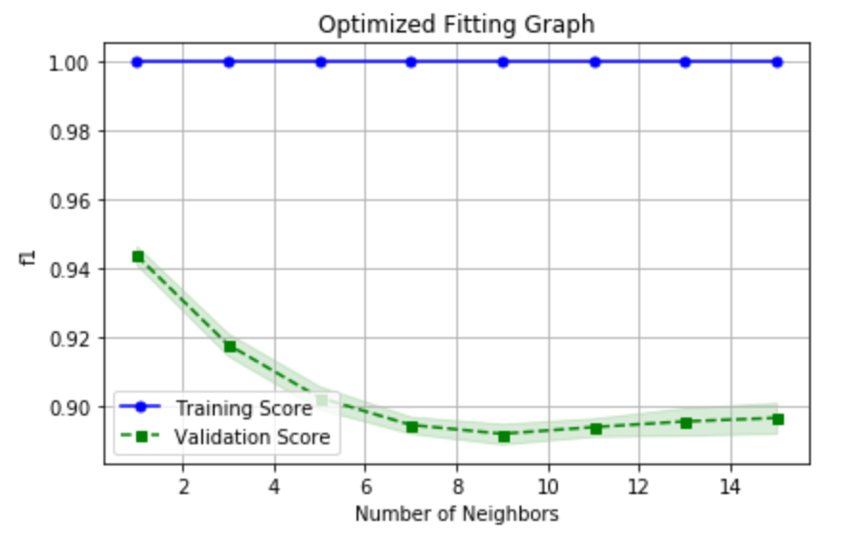
Model: Basic Optimized
Logistic Regression
Decision Tree
k-Nearest Neighbor
C = .001
Penalty = ‘l1’
F1 = 0.7122
Criterion = ‘entropy’
Max_Depth = 38
Min_Samples_split = 10
F1 = 0.9124
3-NN
Manhattan Distance
Weights - Distance
Minkowski
F1 = 0.9091
Business Understanding
Data Understanding
Data Preparation
Model
Evaluation
Deployment

Slide 11
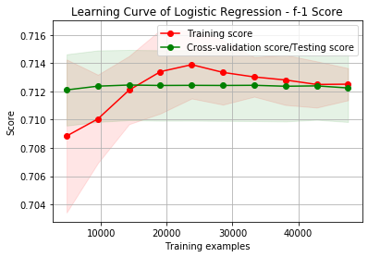
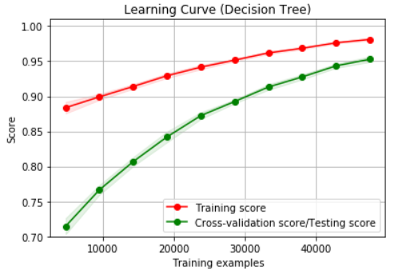
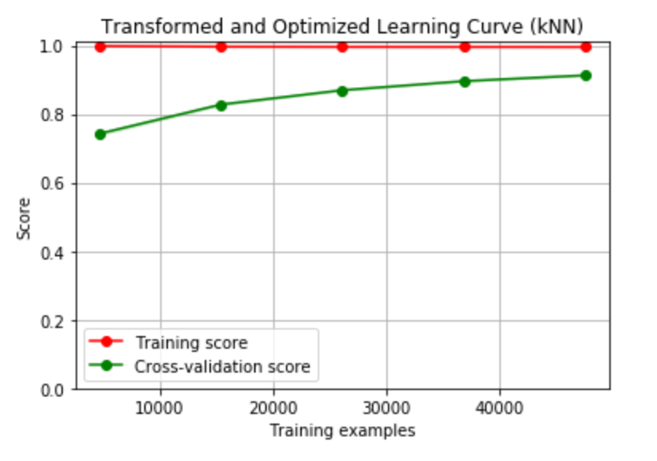
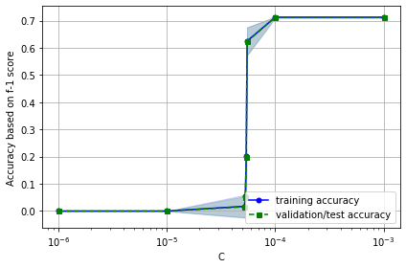
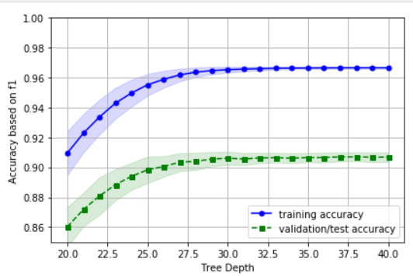
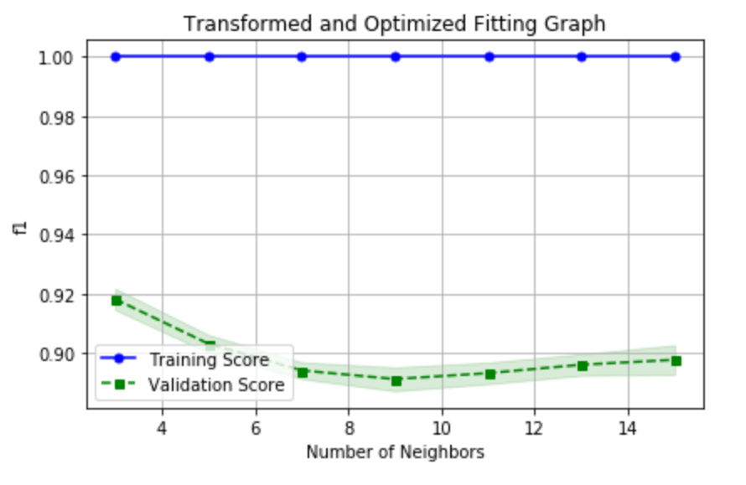
Model: Transformed Optimized
Logistic Regression
Decision Tree
k-Nearest Neighbor
C = .001
Penalty = ‘l1’
F1 = 0.7122
Criterion = ‘entropy’
Max_Depth = 36
Min_Samples_split = 10
F1 = 0.9124
3-NN
Manhattan Distance
Weights - Distance
Minkowski
F1 = 0.9096
Business Understanding
Data Understanding
Data Preparation
Model
Evaluation
Deployment

Slide 12
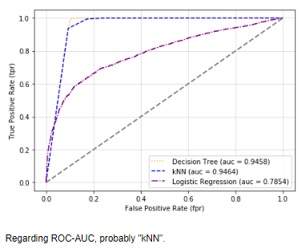
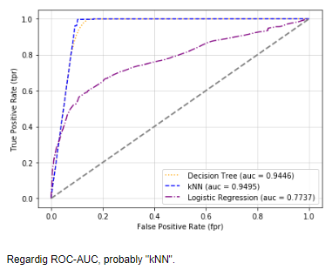
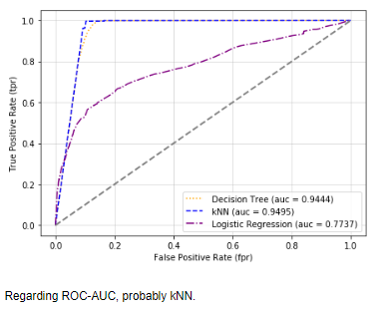
Model: ROC - AUC
Basic - Default
Basic - Optimized
Transformed - Optimized
Decision Tree = .9458
k-NN = .9464
Logistic Regression = .7854
Decision Tree = .9446
k-NN = .9495
Logistic Regression = .7737
Decision Tree = .9444
k-NN = .9495
Logistic Regression = .7737
Business Understanding
Data Understanding
Data Preparation
Model
Evaluation
Deployment

Slide 13

Model Choice
Which Model should we go with?
Logistic Regression
Decision Tree
k-Nearest Neighbor
Default Model Choices
C = 1.0
Penalty = ‘l2’
F1 = 0.7274
Default Model Choices
Criterion = ‘gini’
Min_Samples_Split =2
F1 = 0.9407
Default 3-NN
Euclidean Distance
Minkowski
F1 = 0.8935
Basic
Logistic Regression
Decision Tree
k-Nearest Neighbor
Basic Optimized
C = .001
Penalty = ‘l1’
F1 = 0.7122
Criterion = ‘entropy’
Max_Depth = 38
Min_Samples_split = 10
F1 = 0.9124
3-NN
Manhattan Distance
Weights - Distance
Minkowski
F1 = 0.9091
Logistic Regression
Decision Tree
k-Nearest Neighbor
Transformed Optimized
C = .001
Penalty = ‘l1’
F1 = 0.7122
Criterion = ‘entropy’
Max_Depth = 36
Min_Samples_split = 10
F1 = 0.9124
3-NN
Manhattan Distance
Weights - Distance
Minkowski
F1 = 0.9096
Business Understanding
Data Understanding
Data Preparation
Model
Evaluation
Deployment
Notes:
Targetting those who would convert and not targetting those who would not convert

Slide 14
Model Choice & Evaluation
Which Model should we go with?
AUC
Transformed Optimized k-NN is better by .0051
F1 Score
Transformed Optimized Decision Tree has better F1 score by .0028
Interpretability
Decision Tree is best by revealing a set of rules, easier for managers to understand
Overfitting Concerns
Not going with Basic Decision Tree due to possible overfitting
Transformed Optimized
Decision Tree
Criterion = ‘entropy’
Max_Depth = 36
Min_Samples_split = 10
F1 = 0.9124
Accuracy = .91
Business Understanding
Data Understanding
Data Preparation
Model
Evaluation
Deployment

Slide 15
Naïve Profit
How should the results of the data mining be evaluated?
Cost per call: $.015
Proportional 5% Return on min term deposit → (.05)($1000) = $50
Priority: maximizing profit for every correct model prediction
Deposit
No Deposit
Contact
$49.985 | -$0.015
$0 | $0
No Contact
Business Understanding
Data Understanding
Data Preparation
Model
Evaluation
Deployment
Notes:
This is no better than random guessing
We want to be able to increase the expected value as our model performance increases
We want the bank executives to understand how our model works so interpretability is important
See if they agree with the logic of the model
.89
.11

Slide 16
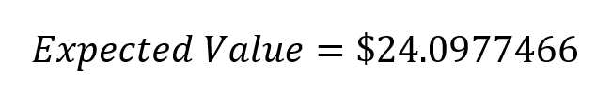
Expected Profit
Expected Value Method
Deposit
No Deposit
Deposit
No Deposit
Contact
8189 | 1167
317 | 7321
Contact
0.4819 | 0.0687
0.0187 | 0.4308
No Contact
No Contact
Deposit
No Deposit
Contact
$49.985 | -$0.015
$0 | $0
No Contact
$12.04338
Business Understanding
Data Understanding
Data Preparation
Model
Evaluation
Deployment
Notes:
A lender may offer a 2% rate for term deposits with a one-year maturity. The funds deposited are then structured as loans to borrowers who are charged 7% in interest on those notes. This difference in rates means that the bank makes a net 5% return ($50 in revenue).
$21.437

Slide 17
Deployment
How will our data mining be deployed?
Preliminary Screening
Pilot Program
Customer Targeting Tweaks
What issues could we have with deployment?
Full Observations with ‘unknowns’
Purchase more consumer data to have complete observations
Prediction Lag
Business Understanding
Data Understanding
Data Preparation
Model
Evaluation
Deployment
Notes:
Preliminary Screening - firstly ask prepared questions regarding these key factors identified from our model
Pilot Program - Implement model in one region and use data (based on specifics about the area) as a test and tune the model
Customer Targeting - target these customers with certain characteristics out of our model
Prediction Lag (due to economies changing after decisions)

Slide 18
Deployment
Are there important ethical considerations?
Personal Data
Do not prey on vulnerable people
What are the risks associated with our proposed plan and how can we mitigate them?
Personal data laws
Different Model Options
Risk of Underfitting and/or Overfitting
Business Understanding
Data Understanding
Data Preparation
Model
Evaluation
Deployment
Notes:
e.g.: Risk of model building specific to only this type of bank or product

Slide 19
Thank you!
Questions?

Slide 20
Appendix

Slide 21
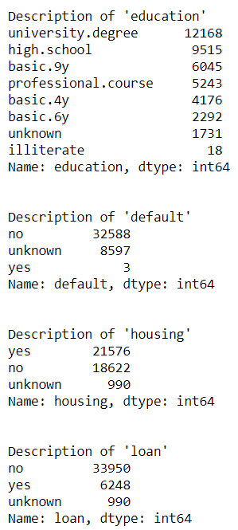
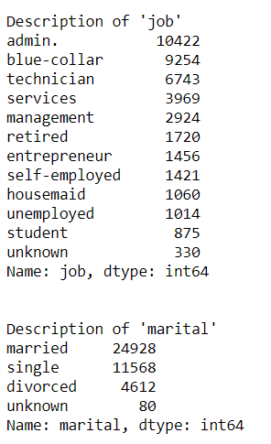
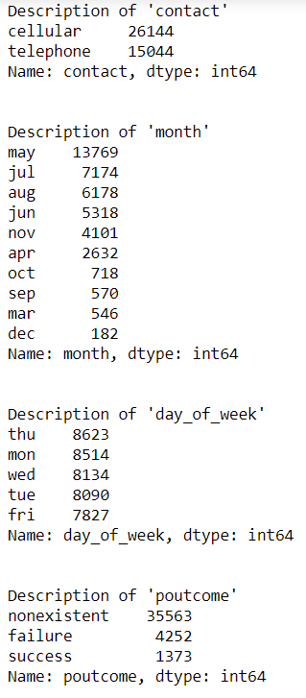
Data Understanding
Qualitative Data
Business Understanding
Data Understanding
Data Preparation
Model
Evaluation
Deployment

Slide 22
Data Understanding
Qualitative Data
Business Understanding
Data Understanding
Data Preparation
Model
Evaluation
Deployment

Slide 23
Data Understanding
Qualitative Data
Business Understanding
Data Understanding
Data Preparation
Model
Evaluation
Deployment

Slide 24
Data Understanding
Qualitative Data
Business Understanding
Data Understanding
Data Preparation
Model
Evaluation
Deployment

Slide 25
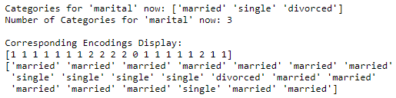
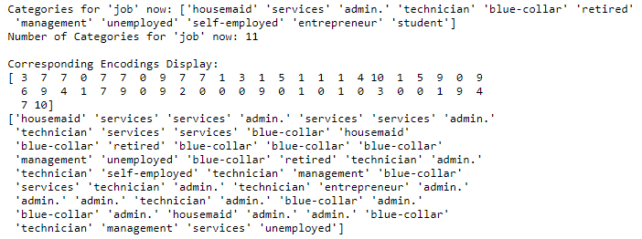
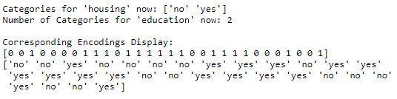
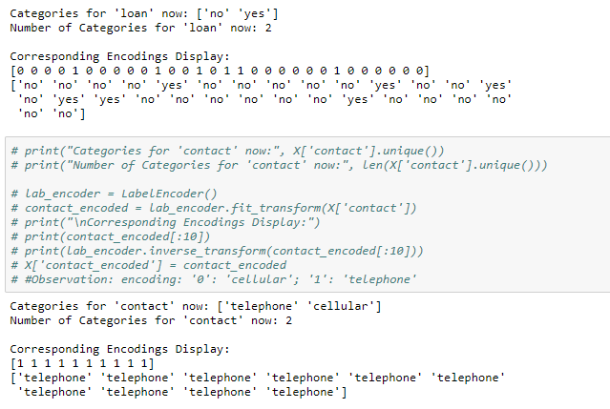
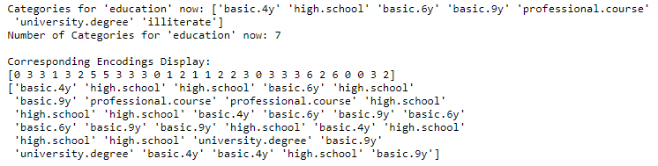
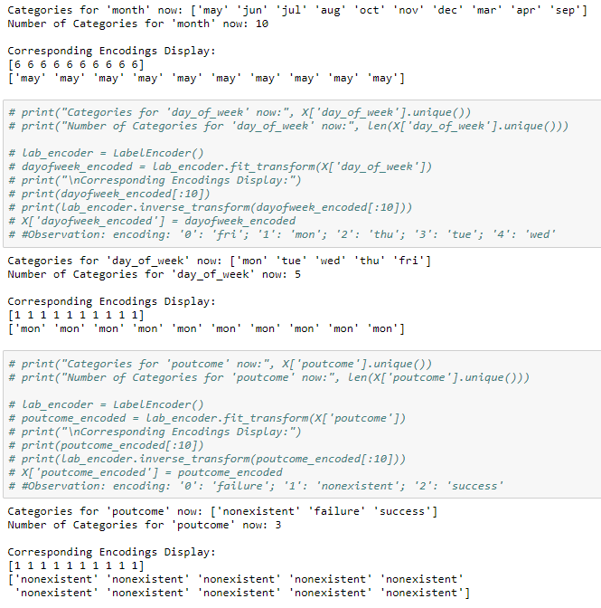
Data Preparation
Data Encoding
Business Understanding
Data Understanding
Data Preparation
Model
Evaluation
Deployment

Slide 26
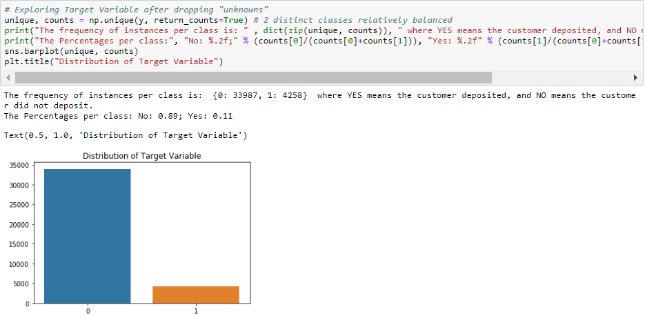
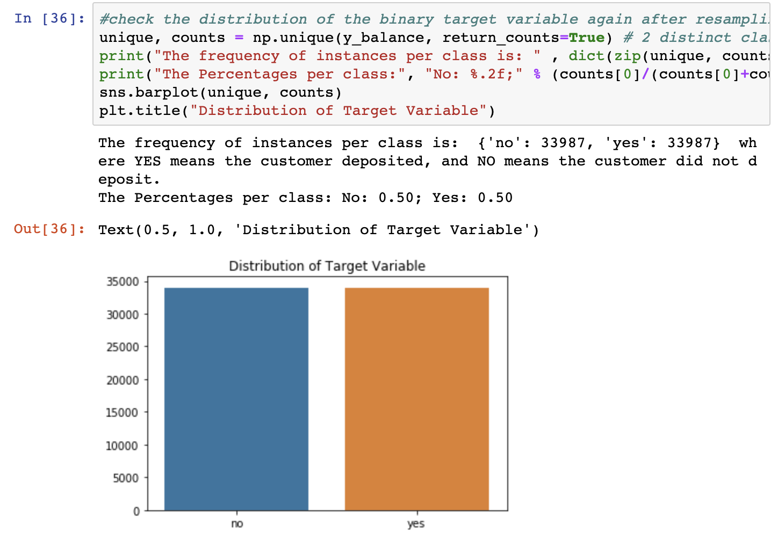
Data Preparation
Data Rebalancing with Resampling Technique
Before Resampling
After Resampling
Business Understanding
Data Understanding
Data Preparation
Model
Evaluation
Deployment

Slide 27
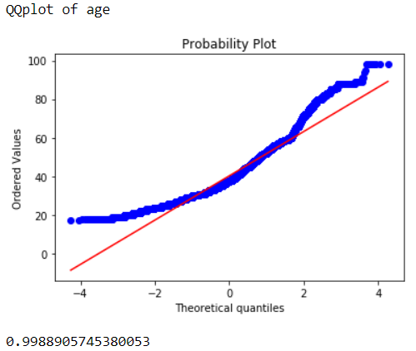
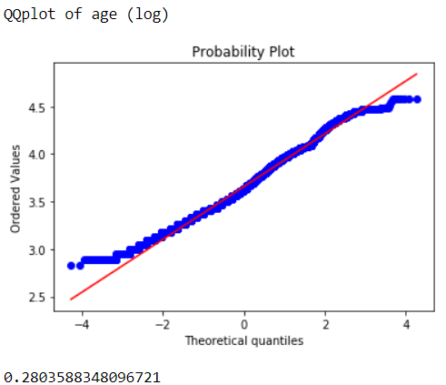
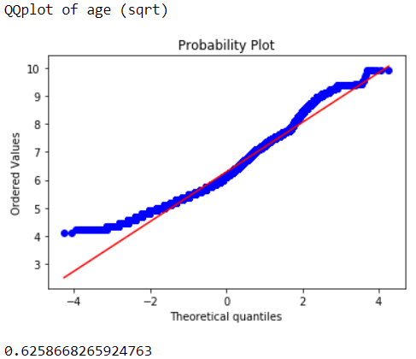
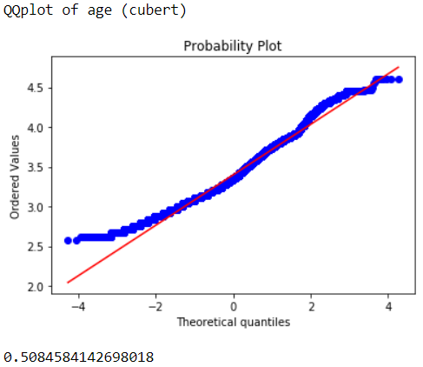
Data Preparation
Transformations
Procedure:
We wanted feature data to be as normal as possible
Plotted the Q-Q plots and skewness of each feature with different transformations
Business Understanding
Data Understanding
Data Preparation
Model
Evaluation
Deployment

Slide 28
Data Preparation
Transformations
Log Transformations
age: log()
campaign: log()
Log Transformations for
Features with ‘0’
pdays: log(x+2)
previous: log(x+2)
job_encoded: log(x+2)
housing_encoded: log(x+2)
loan_encoded: sqrt(x+2)
contact_encoded: sqrt(x+2)
Sqrt Transformations for Features with Negative Values
cons.conf.idx: sqrt(x+1- min(X[]))
Business Understanding
Data Understanding
Data Preparation
Model
Evaluation
Deployment

Slide 29
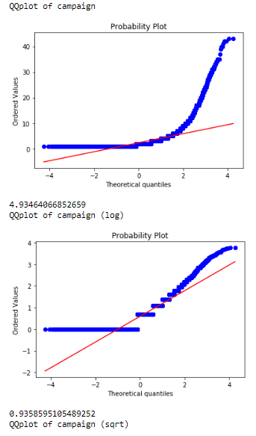
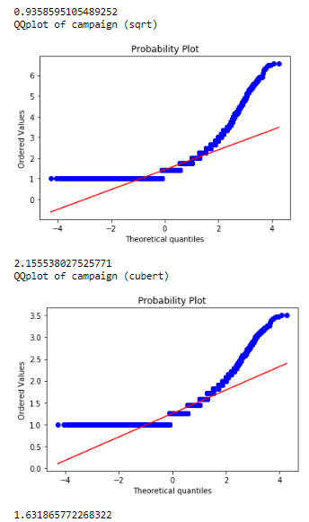
Data Preparation
Transformation

Slide 30
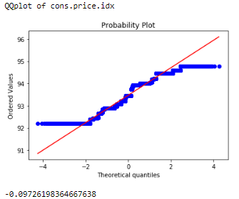
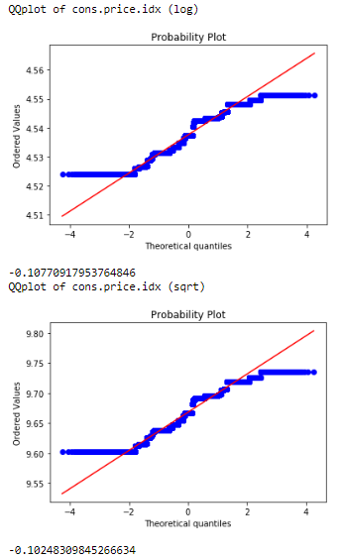
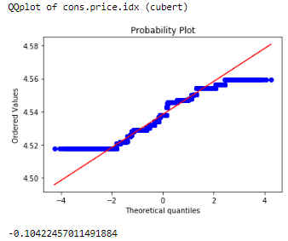




Data Preparation
Transformation

Slide 31








Data Preparation
Transformation

Slide 32








Data Preparation
Transformation

Slide 33








Data Preparation
Transformation

Slide 34








Data Preparation
Transformation

Slide 35








Data Preparation
Transformation

Slide 36








Data Preparation
Transformation

Slide 37








Data Preparation
Transformation

Slide 38








Data Preparation
Transformation

Slide 39








Data Preparation
Transformation

Slide 40








Data Preparation
Transformation

Slide 41


Model - Basic
Logistic Regression

Slide 42


Model - Basic
Decision Tree

Slide 43


Model - Basic
k-NN

Slide 44


Model - Basic Optimized
Logistic Regression

Slide 45


Model - Basic Optimized
Decision Tree

Slide 46


Model - Basic Optimized
k-NN

Slide 47


Model - Transformed Optimized
Logistic Regression

Slide 48


Model - Transformed Optimized
Decision Tree

Slide 49


Model - Transformed Optimized
k-NN

Slide 50
I). About potential bank client characteristics:
“age” (numeric)
“job” : type of job (categorical: 'admin.', 'blue-collar', 'entrepreneur', 'housemaid', 'management', 'retired', 'self-employed', 'services', 'student', 'technician', 'unemployed', 'unknown')
“marital”: marital status (categorical: 'divorced'(meaning divorced or widowed), 'married', 'single', 'unknown’)
“education” (categorical: 'basic.4y', 'basic.6y', 'basic.9y', 'high.school', 'illiterate', 'professional.course', 'university.degree', 'unknown')
“default”: has credit in default or not? (categorical: 'no','yes','unknown')
“housing”: has housing loan or not? (categorical: 'no','yes','unknown')
“loan”: has personal loan or not? (categorical: 'no','yes','unknown')
II). About the last contact of the current campaign:
“contact”: contact communication type (categorical: 'cellular','telephone')
“month”: last contact month of year (categorical: 'jan', 'feb', 'mar', ..., 'nov', 'dec')
“day_of_week”: last contact day of the week (categorical: 'mon','tue','wed','thu','fri')
III). About historical campaigns:
“campaign”: number of contacts performed during this campaign and for this client (numeric, includes last contact)
“pdays”: number of days that passed by after the client was last contacted from a previous campaign (numeric; 999 means client was not previously contacted)
“previous”: number of contacts performed before this campaign and for this client (numeric)
“poutcome”: outcome of the previous marketing campaign (categorical: 'failure','nonexistent','success')
IV). About social and economic context:
“emp.var.rate”: employment variation rate - quarterly indicator (numeric)
“cons.price.idx”: consumer price index - monthly indicator (numeric)
“cons.conf.idx”: consumer confidence index - monthly indicator (numeric)
“euribor3m”: euribor 3 month rate - daily indicator (numeric)
“nr.employed”: number of employees - quarterly indicator (numeric)

